Slide 1

Contact Management System
Data Structures Lab Project
Presented by
Muhammad Mehroz
FA20-BSE-071

Slide 2

Short Description
This is a console based project. As it tells from it name that it will mange the contacts like saving the contacts in order, deleting the contacts, updating the contacts, show recent search contacts , search the contacts and add contacts to the favorite.

Slide 3
Modules or Functions
Save Contacts Info
Delete the Contacts
Search the Contacts
Add Favorites Contacts
Edit the Contacts
Display Contacts

Slide 4

Data Structures Used
Linked List
Stack

Slide 5

Saving Contact Info Function
Contacts will be stored in the linked list , an “insert_Contact” is the function which is performing all this task.
This function takes head, name , email and number as an argument.
This function also compares the new name with the existing contacts to check if the contact is already present or not. if the contact does not exist, then add that contact to the list.
If contact exist it displays the message of “Contact is Already Present”.

Slide 6
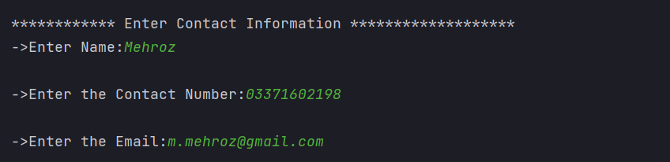
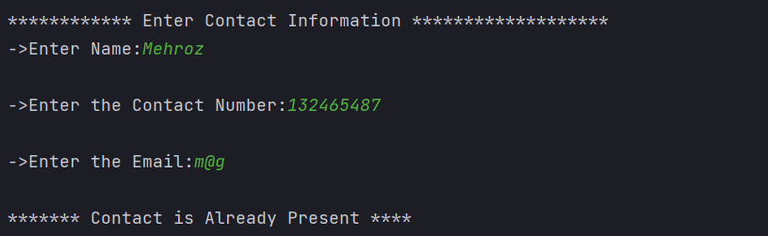
Screen shot of Output
First Contact is Added
If the name is present in the list so it displays a message that “contact is already present”

Slide 7

Delete Contacts Function
There are 2 delete functions in this project 1 is delete form main contact list and 2 is delete from favorite contact list.
1. 1st delete function name is delete_contact
2. 2nd delete function name is del_fav
Delete_contact function also checks that if the contact also present in the fav contact list or not if present then it calls the del_fav function too.
If user wants to delete the contact form the fav contact list only then del_fav functions come in and delete the contact from the fav contact list.

Slide 8
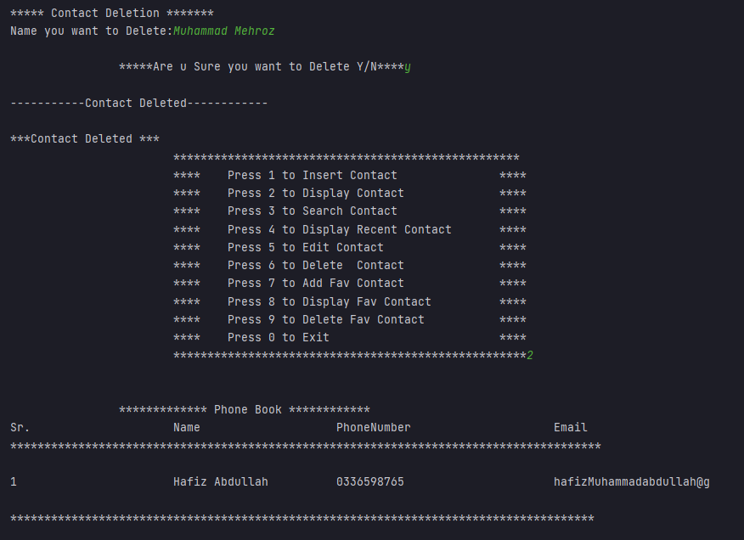
Screen shot of Output delete_contact and del_fav Functions

Slide 9

Search Contact Function
User can search contacts by giving contact number , email and also by name of contact. All this is performing by search_contact function.
This function just compare the name or email or contact number in the list , if the contact found then displays the details of that contact , if not found then displays a message of contact not found.
This function also inserts the searched name of the contact in the recent contact list
Recent_contact is the function which takes the searched name as an argument from the search function and just add to the stack.

Slide 10
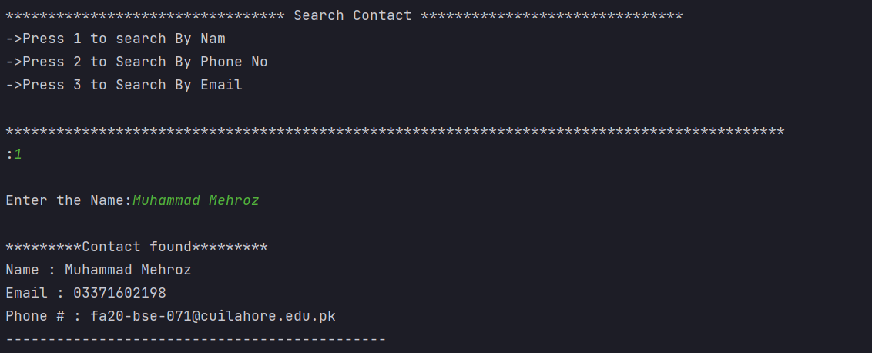
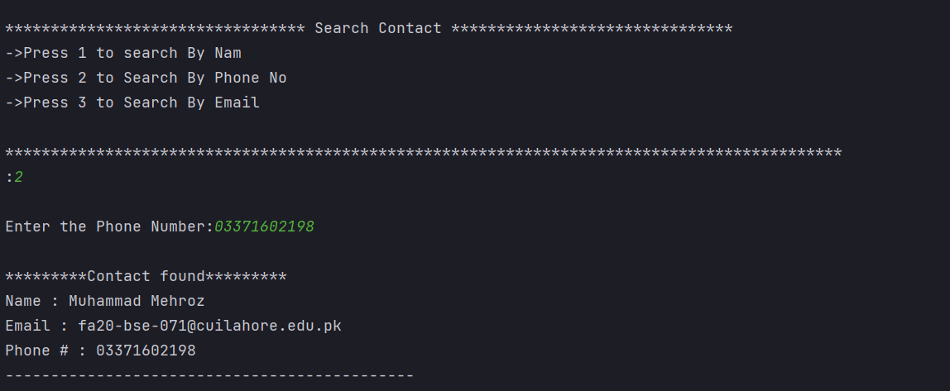
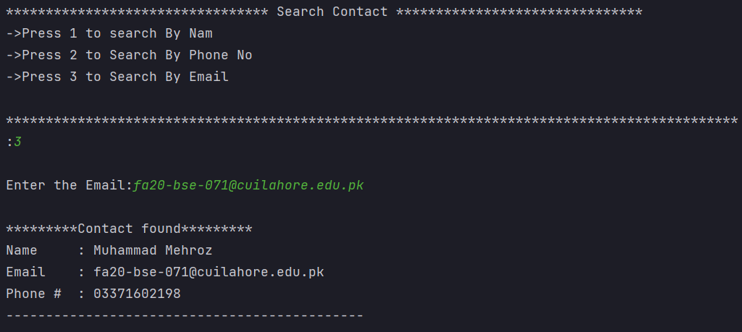
Screen shot of search function
Result of Search by Name
Result of Search by Phone Number
Result of Search by Email

Slide 11
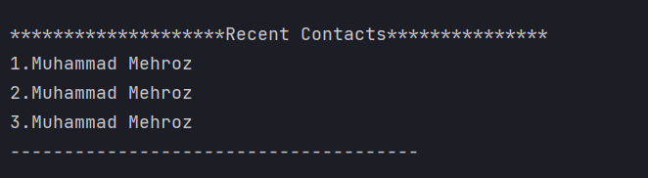
Recent search Record
These are the Contacts which we have searched recently.

Slide 12

Add Favorites Contacts
User can add existing contact to favorite contact list.
For that there is a function named add_fav_Contact. The prerequisite for this function is that the name has to be in the original contact list.
Duplication contact is also not allowed in this list too.

Slide 13
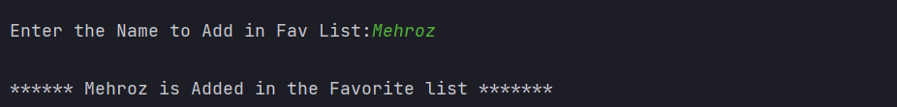
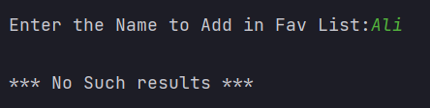
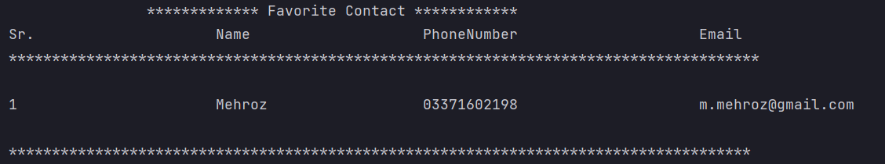
Screen shot of Output add_fav_contact Function
As the name is present in the original list it added in the fav list of Contacts
As the name is present in the original list it added in the fav list of Contacts
As the name is not present in the original list it shows the message No Such Result
Display of the fav Contact List

Slide 14

Edit Contacts
User can edit the contact info of the contact which he wants , user has to enter the name of that contact and function update_function will do the rest of the job.
Update_function will search the contact show the original data of that contact and after that ask for new data and replace the old data with the new data of that contact.
This function also checks that if the contact is present in the fav contact list or not, if present it also updates the record over there too.

Slide 15
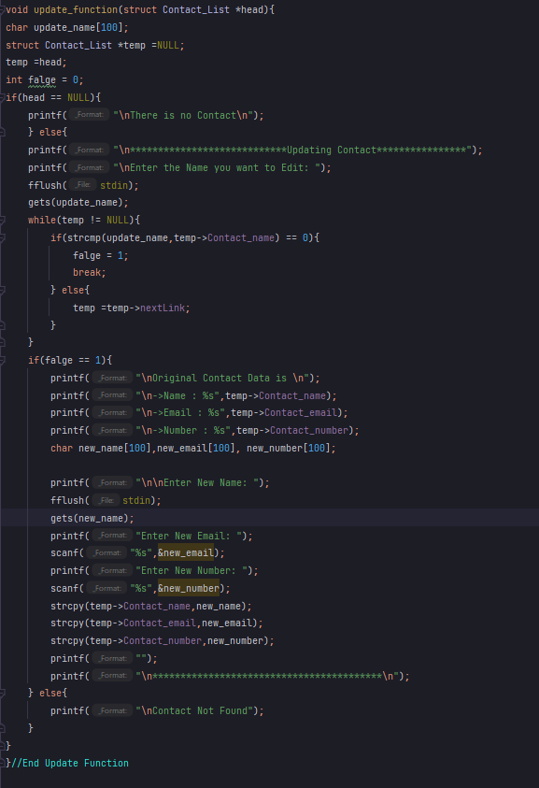
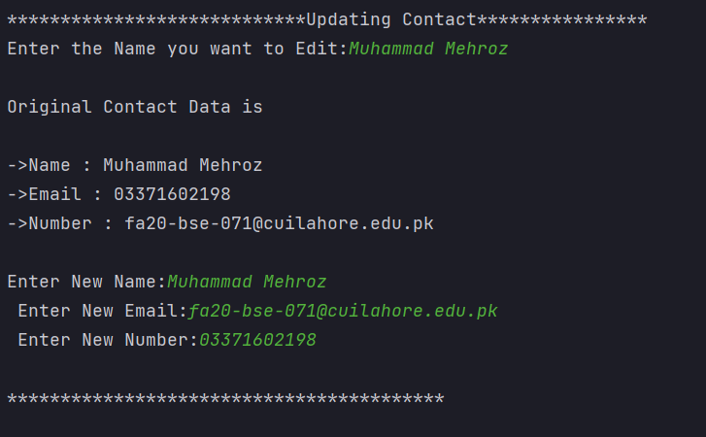
Screen shot of update function

Slide 16

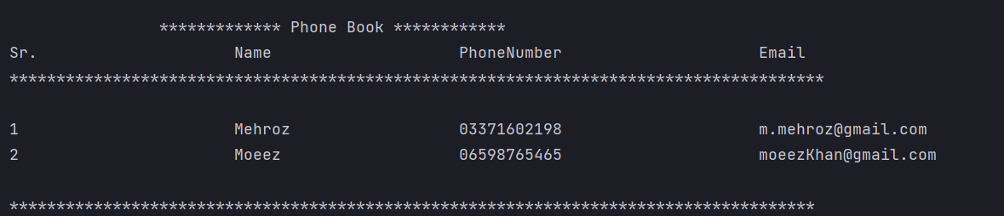
Display function
User can see all the contact present in the phone book by using the display function.

Slide 17
Thank You

